Slide 1
Branch and Bound
Yash N.C.
181210062

Slide 2
Branch and Bound
Branch and bound is an algorithm design paradigm which is generally used for solving combinatorial optimization problems. These problems are typically exponential in terms of time complexity and may require exploring all possible permutations in worst case. The Branch and Bound Algorithm technique solves these problems relatively quickly.

Slide 3
How Branch and Bound Works ?
A branch-and-bound algorithm consists of a systematic enumeration of candidate solutions by means of state space search: the set of candidate solutions is thought of as forming a rooted tree with the full set at the root. The algorithm explores branches of this tree, which represent subsets of the solution set. Before enumerating the candidate solutions of a branch, the branch is checked against upper and lower estimated bounds on the optimal solution, and is discarded if it cannot produce a better solution than the best one found so far by the algorithm.

Slide 4
Advantages
Branch and Bound searches for best solution than the one found before , due to this the probability of repetition is very low
A unique model for all types of discrete optimization problems is that a general purpose Branch and Bound method is available.
Disadvantages
Branch and bound algorithm is parallelization difficult
Branch and bound algorithm is not ideal for large networks as the solutions space grows with the scale of the network

Slide 5
Real Life Applications of Branch and Bound
NP-hard problems Integer programming
Nonlinear programming
Travelling salesman problem
Quadratic assignment problem
Maximum satisfiability problem
Nearest neighbor search
Flow shop scheduling
Job Assignment Problem
0/1 Knapsack problem

Slide 6
Traveling Salesman Problem
(Branch and Bound)
Given a set of cities and distance between every pair of cities, the problem is to find the shortest possible tour that visits every city exactly once and returns to the starting point.

Slide 7
Idea of solving problem using Branch and bound
In Branch and Bound method, for current node in tree, we compute a bound on best possible solution that we can get if we down this node. If the bound on best possible solution itself is worse than current best (best computed so far), then we ignore the subtree rooted with the node. Note that the cost through a node includes two costs.
1) Cost of reaching the node from the root (When we reach a node, we have this cost computed
2) Cost of reaching an answer from current node to a leaf (We compute a bound on this cost to decide whether to ignore subtree with this node or not).

Slide 8
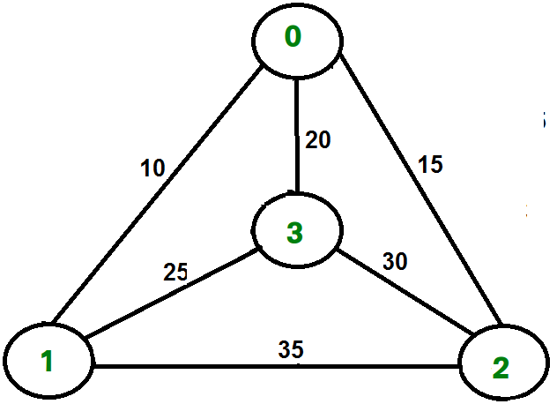
Idea of solving problem using Branch and bound (Algo)
Example :
Consider the graph shown in figure on right side. A TSP tour in the graph is 0-1-3-2-0. The cost of the tour is 10+25+30+15 which is 80.

Slide 9
Why use Branch and Bound for the Problem ?
Branch and bound is ideal for this problem as the time algorithm as it can traverse in both Depth First Search and Breadth First Search to find the optimal solution. It completely searches the state space tree to get optimal solution. Backtracking is not perfect for this problem as if backtracking realizes that it has made a bad choice & undoes the last choice by backing up but in branch and bound algorithm realizes that it already has a better optimal solution that the pre-solution leads to so it abandons that pre-solution which save computing time.

